Slide 1

How to install Packer in Windows 10?
Agenda

Slide 2
Packer may be installed in the following ways:
Using a precompiled binary; We release binaries for all supported platforms and architectures. This method is recommended for most users.
Installing from source This method is only recommended for advanced users.
An unofficial alternative installation method

Slide 3
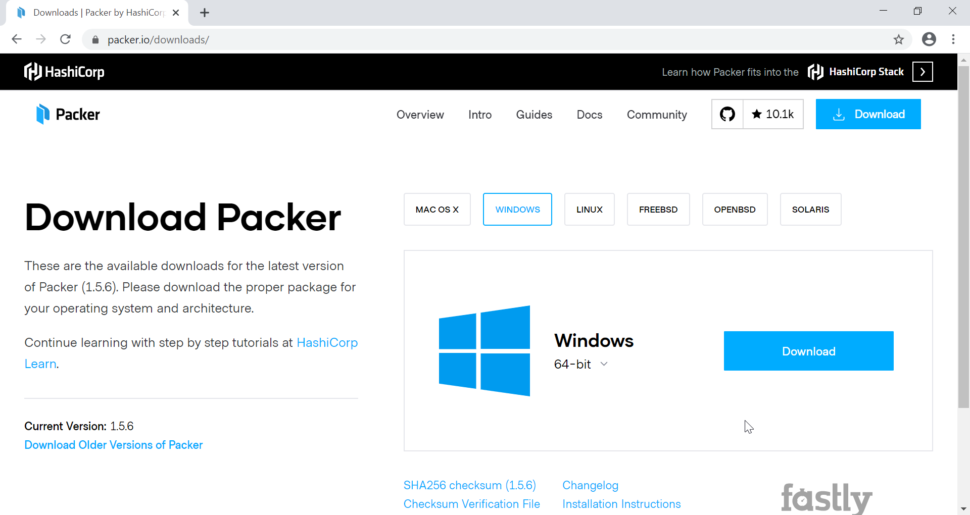

Slide 4
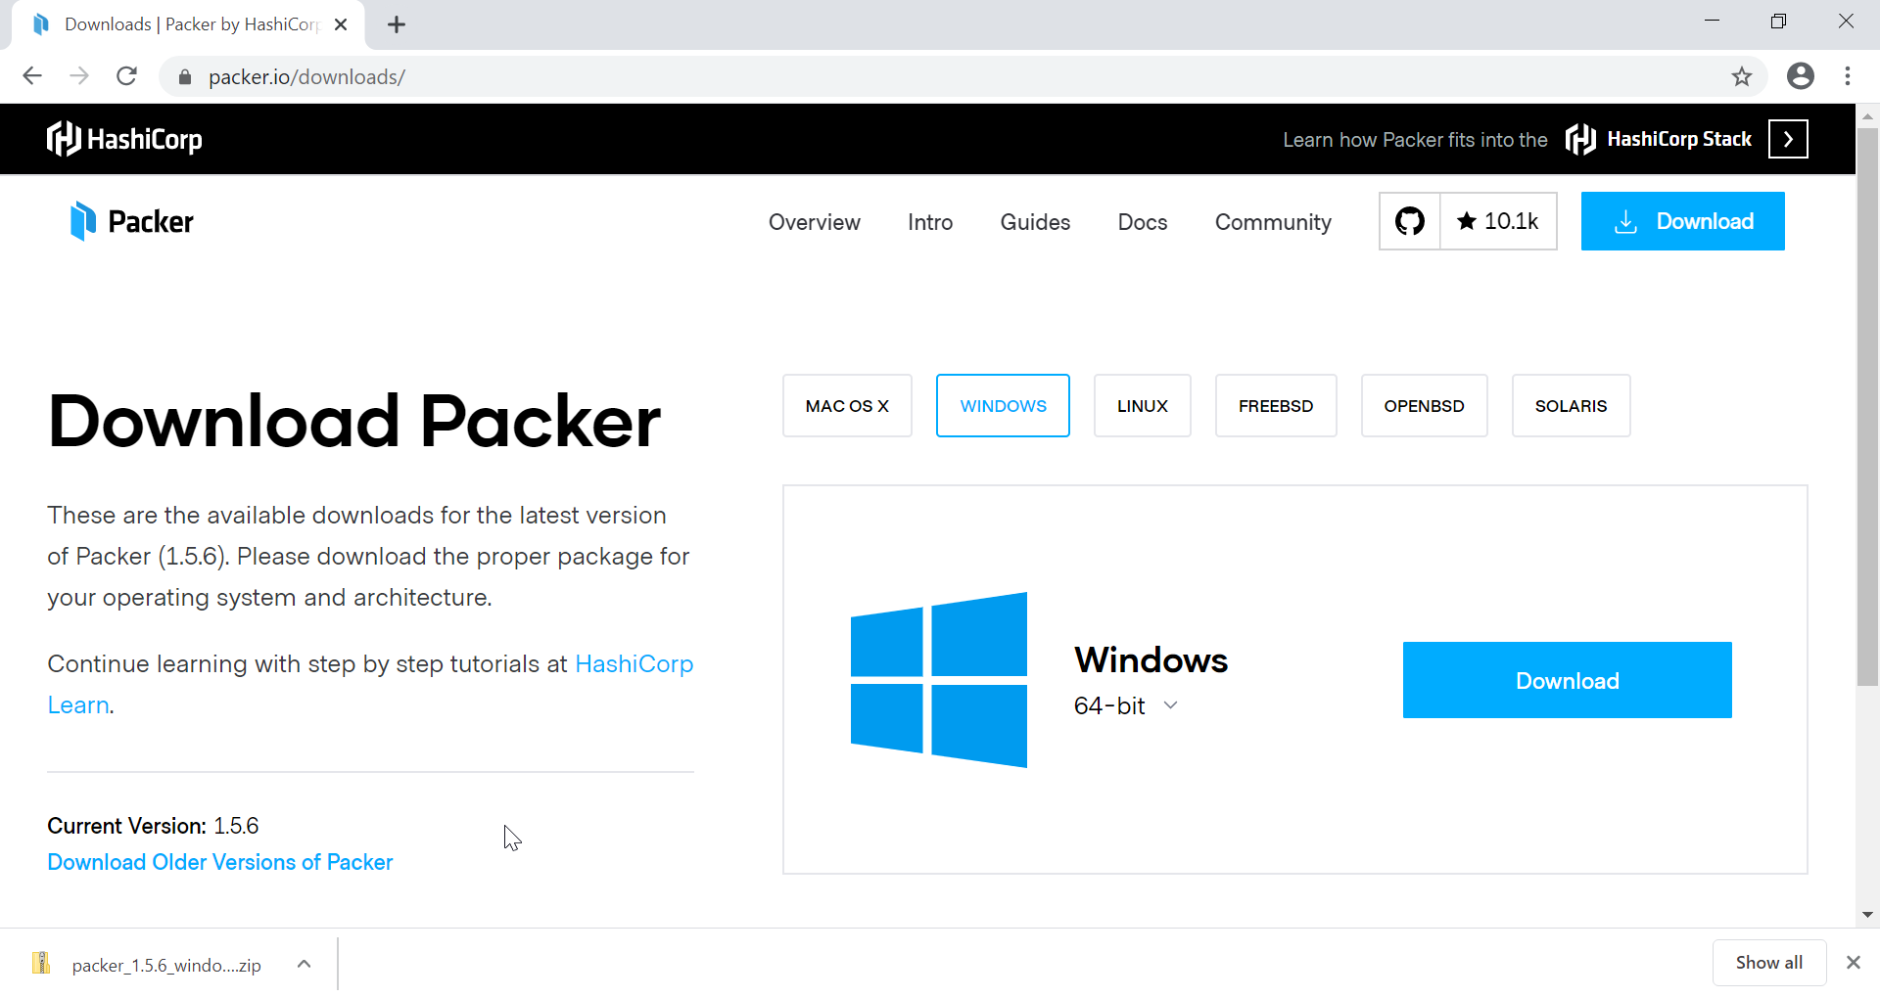

Slide 5
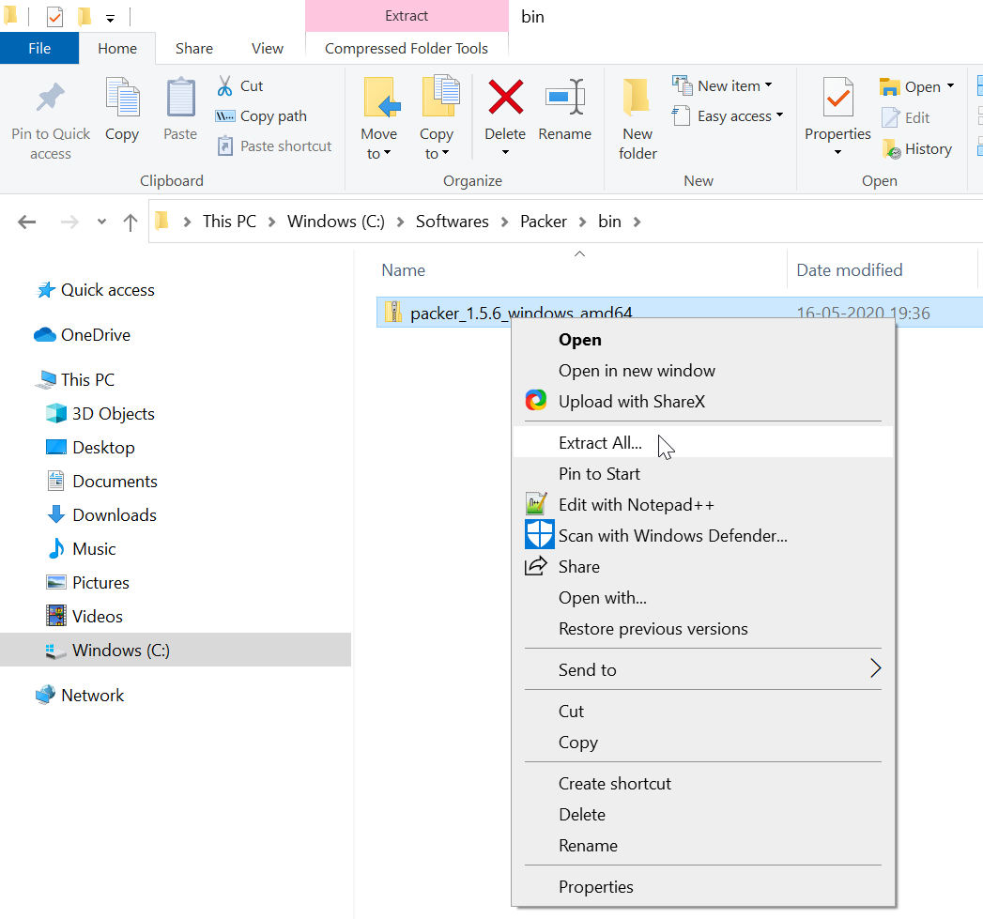

Slide 6
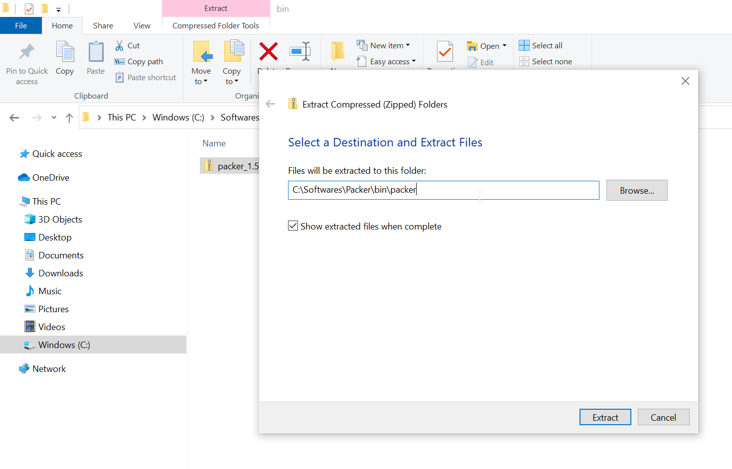

Slide 7
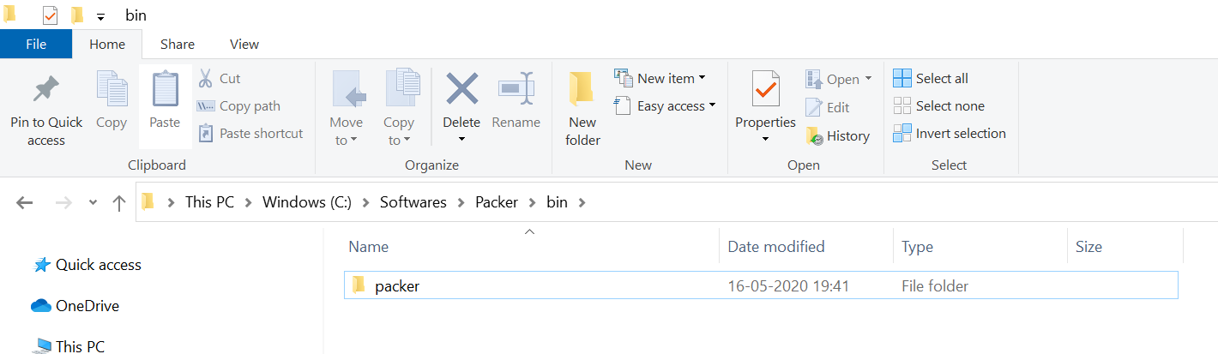

Slide 8
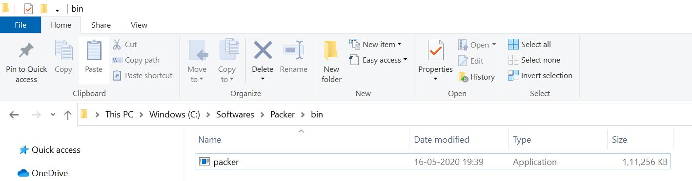

Slide 9
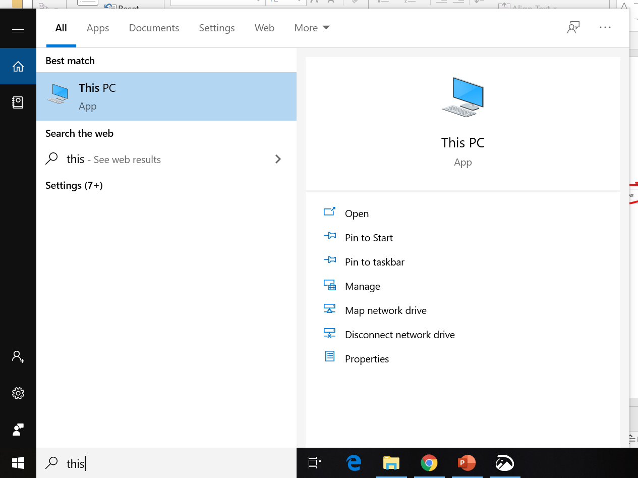

Slide 10
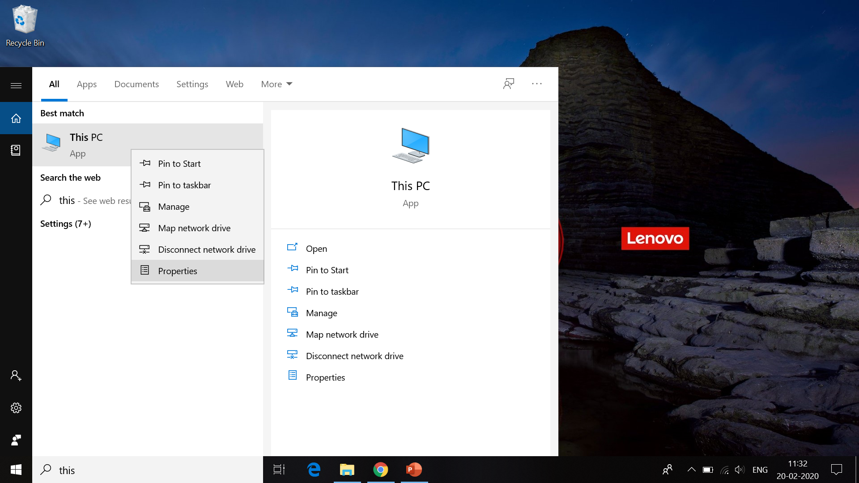

Slide 11
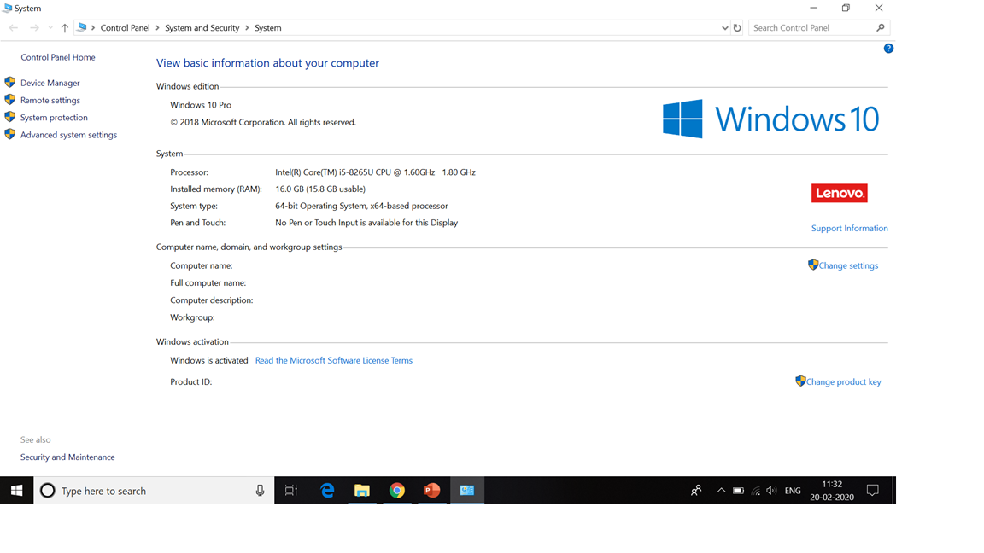

Slide 12
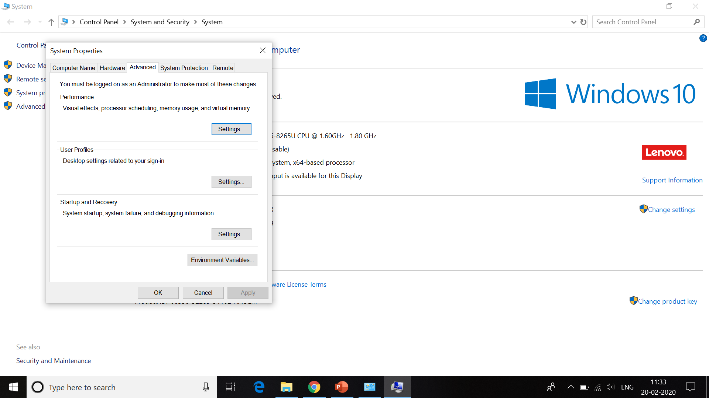

Slide 13
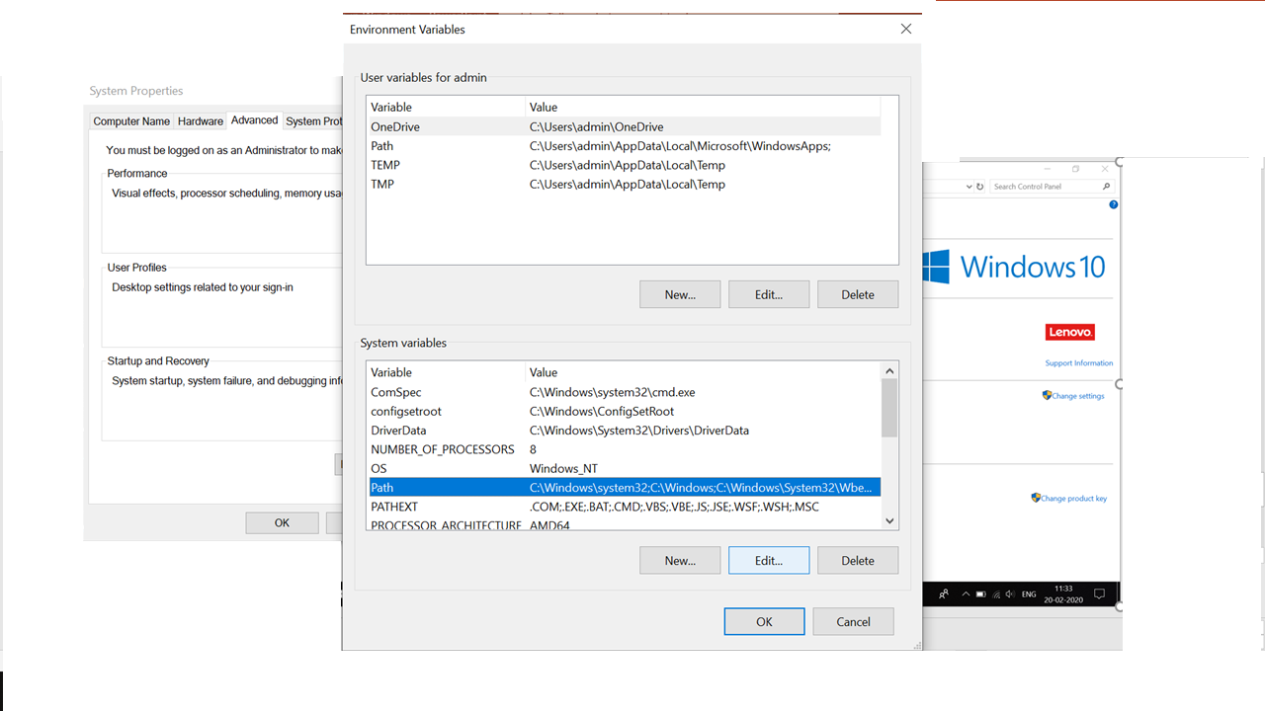

Slide 14
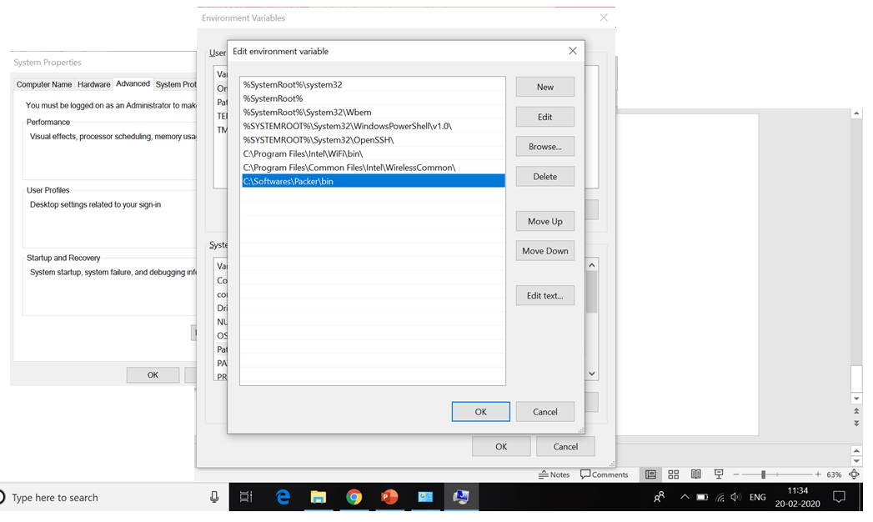

Slide 15
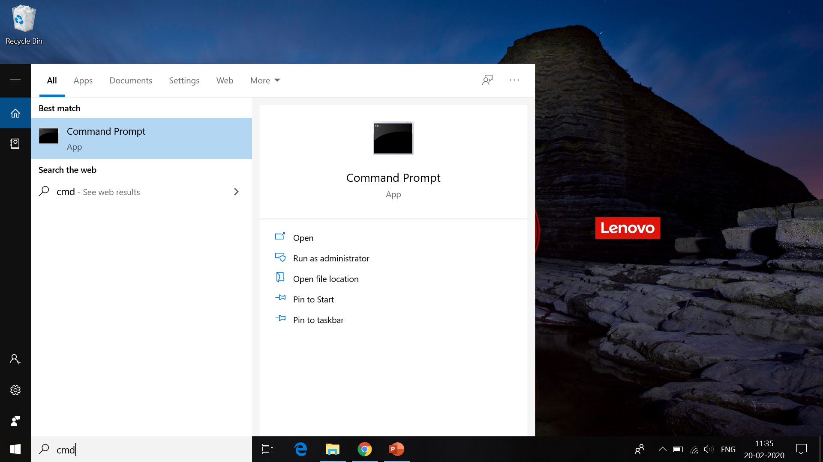

Slide 16
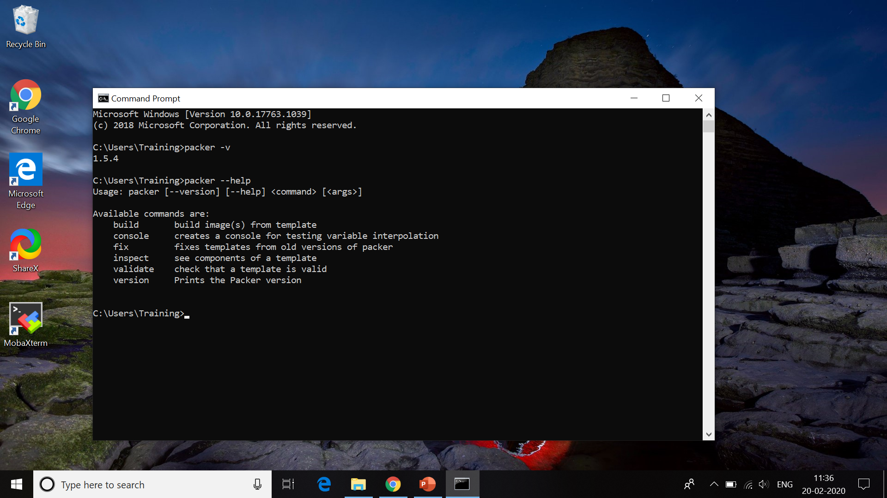

Slide 17
How to install Packer in Windows 10?
Installation Verification
Understanding of few commands
Summary

